Slide 1
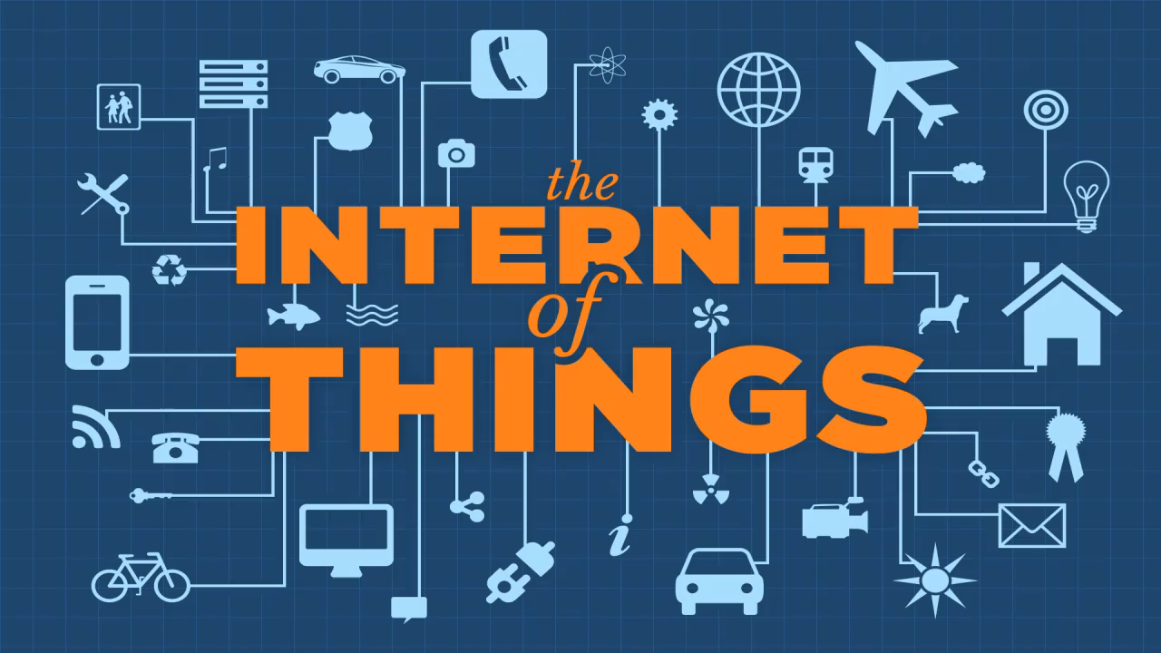

Slide 2

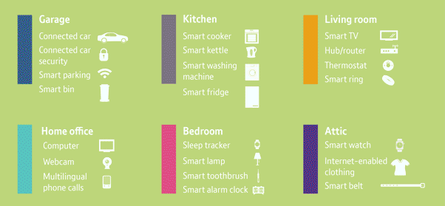
The Internet of Things (IoT) is the network of physical objects—devices, vehicles, buildings and other items- embedded with electronics, software, sensors, and network connectivity that enables these objects to collect and exchange data.

Slide 3
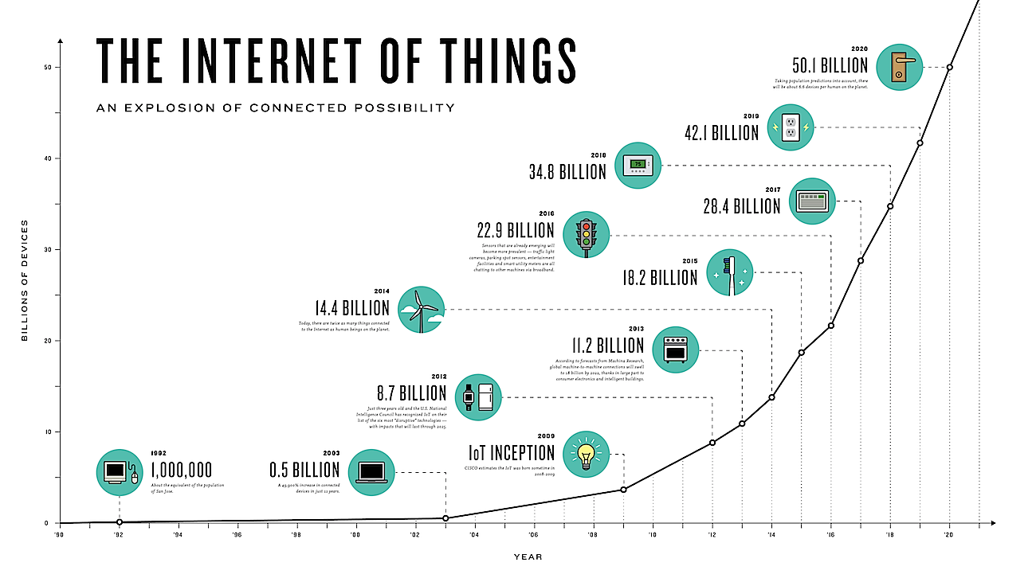

Slide 4
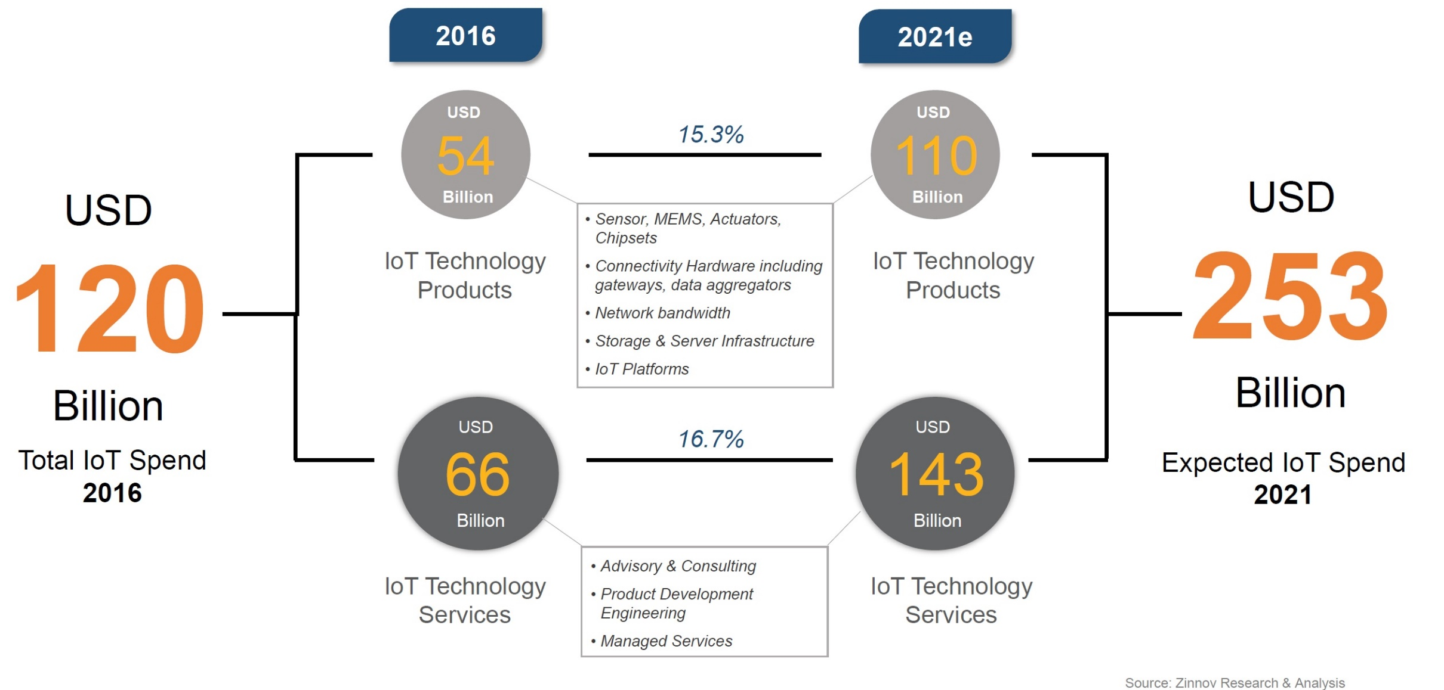

Slide 5
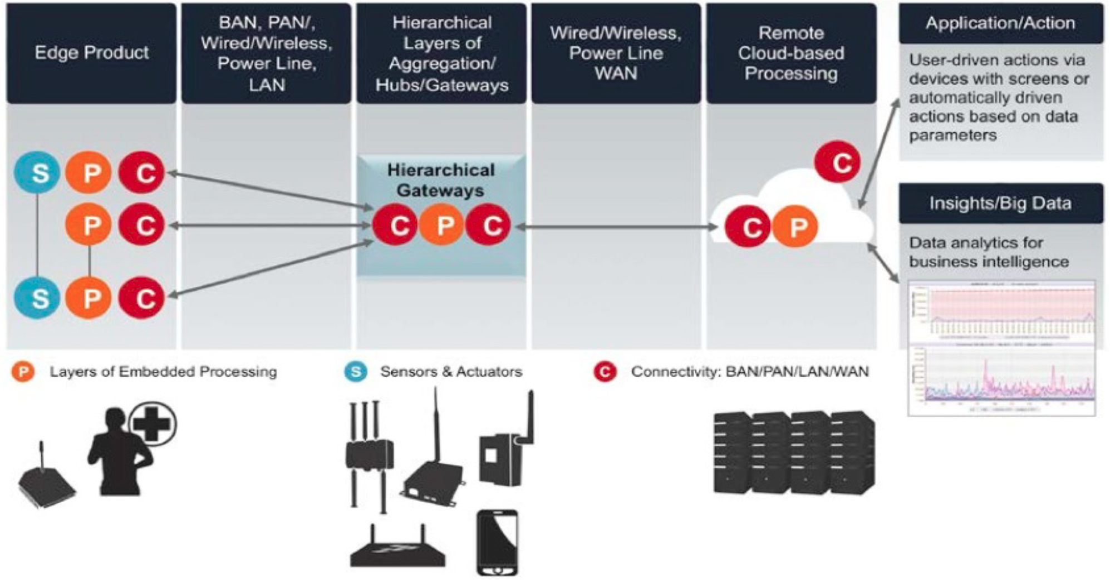

Slide 6
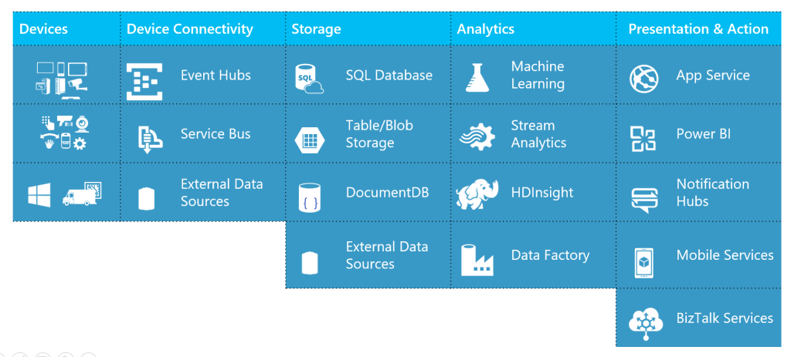
Azure IoT Stack

Slide 7
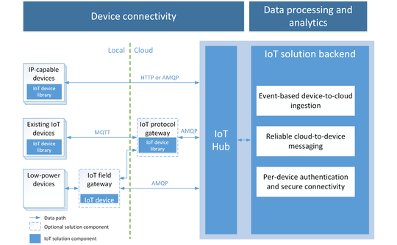
Azure IoT Hub

Slide 8
Monitoring

Slide 9

$50.
Arduino WiFi 101 Shield
MKR1000
Yún Shield
https://create.arduino.cc/iot/

Slide 10


802.11n WiFi
Bluetooth 4.0
Quad-core 64-bit ARM Cortex A53
1.2 GHz.
It’s a usable desktop computer.
$35.

Slide 11
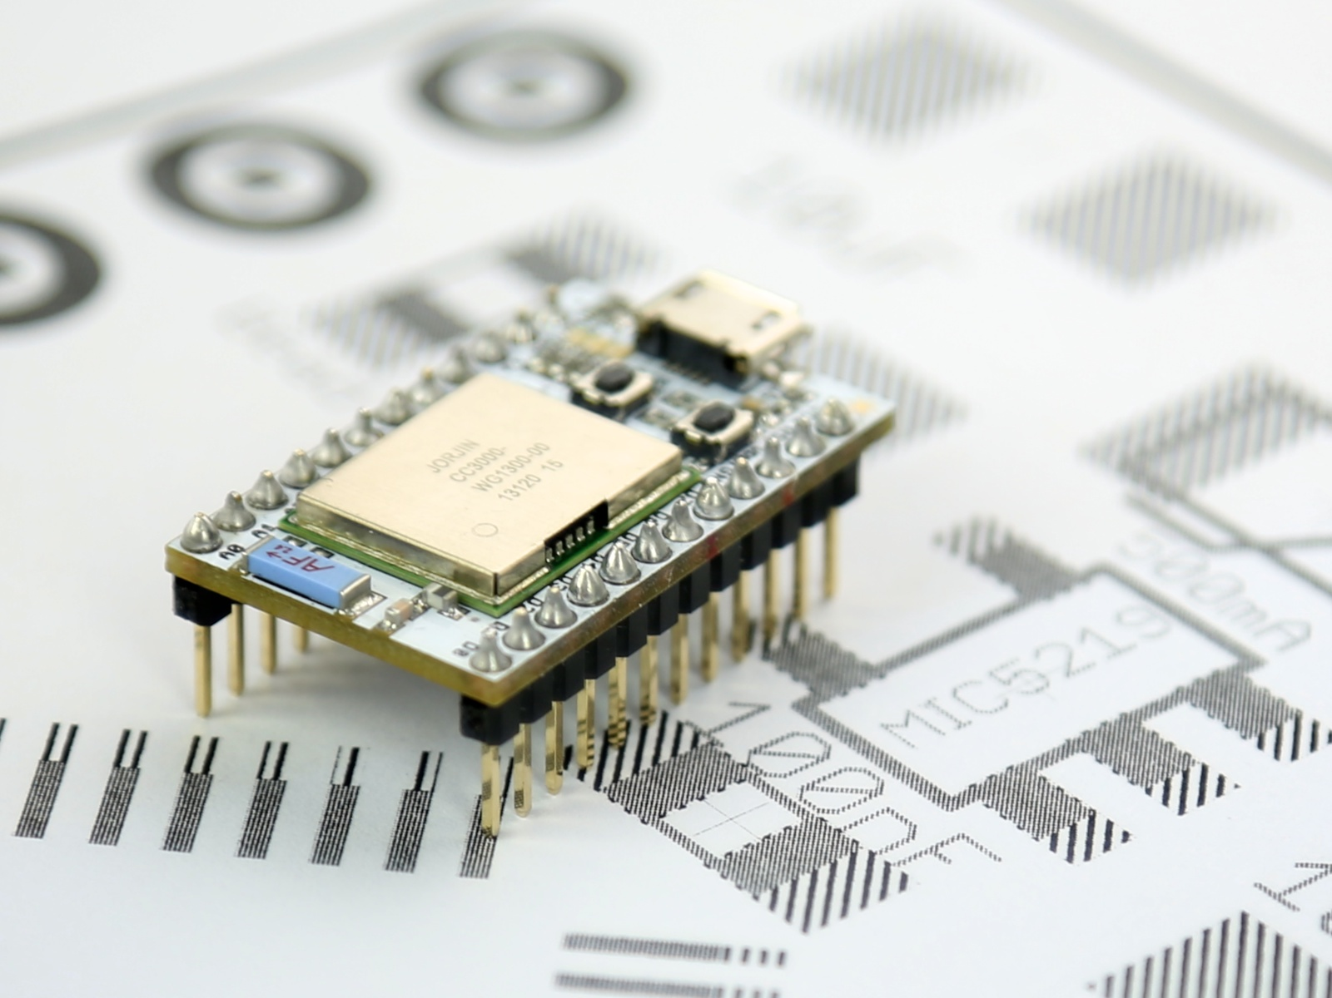
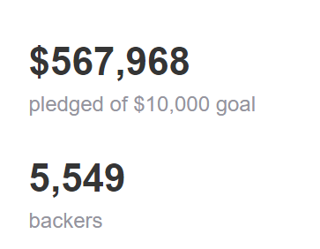
A tiny Wi-Fi development board. Arduino
+ Wi-Fi
+ ARM Cortex M3
+ wireless programming
+ REST API
= awesome.
$19.

Slide 12
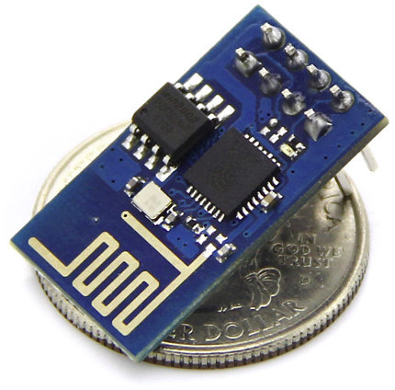
$3

Slide 13
Demo
1. LED Blinking
2. Hello World on OLED
3. Connect to WiFi

Slide 14
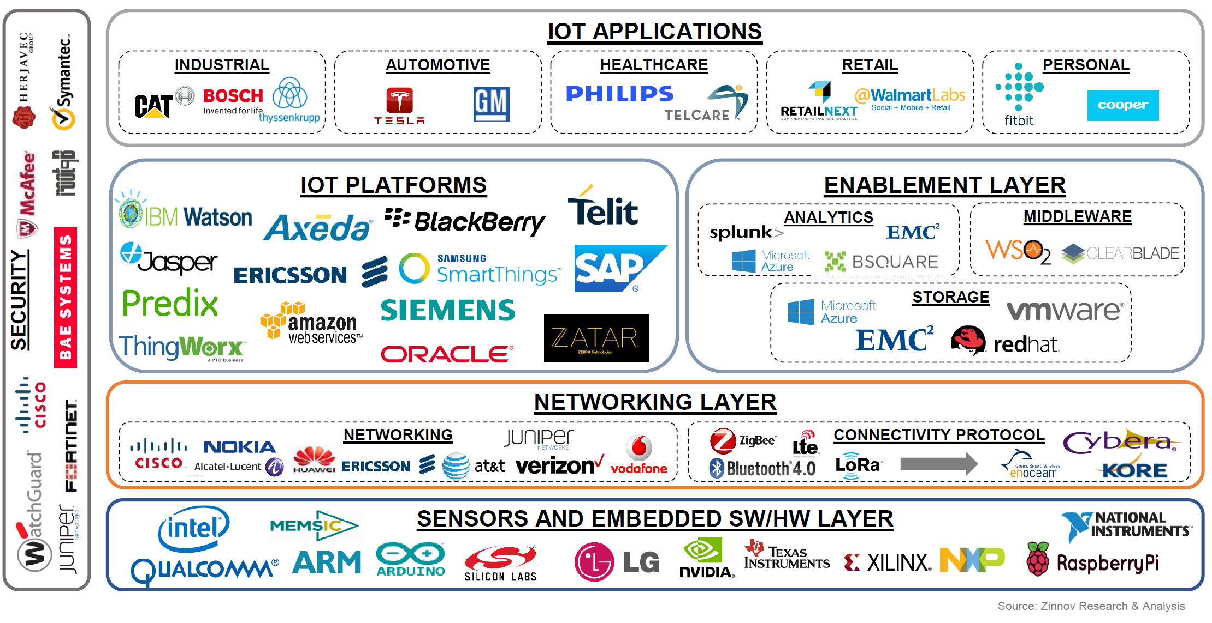

Slide 15
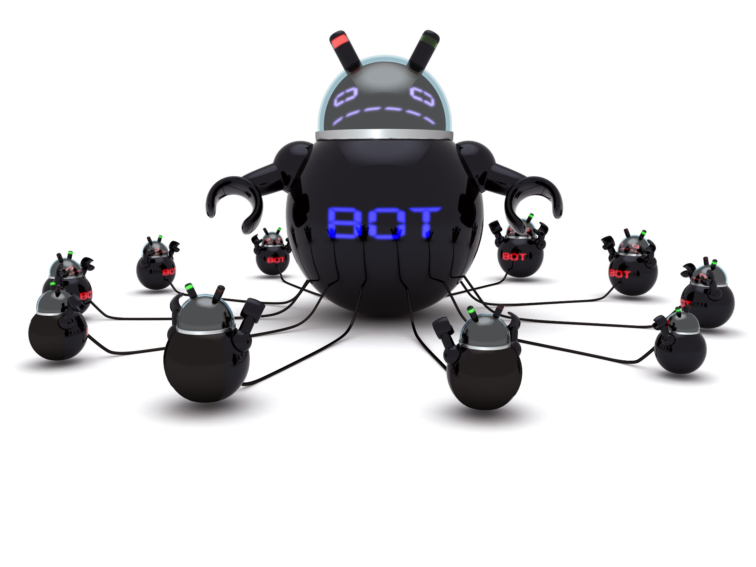
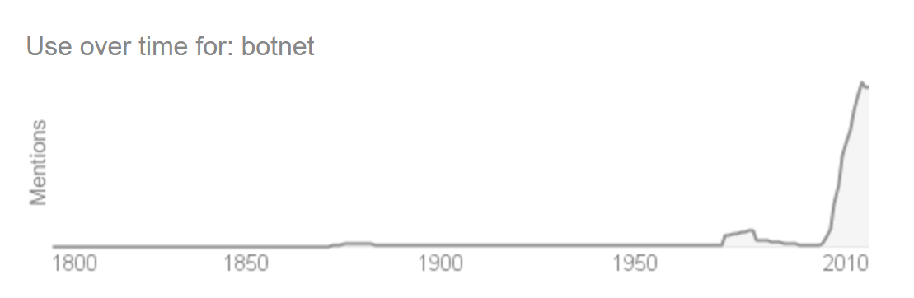
A botnet is a number of Internet-connected computers autonomously communicating with other similar machines in which components located on networked computers communicate and coordinate their actions by command and control (C&C) or by passing messages to one another without the owners' knowledge.

Slide 16
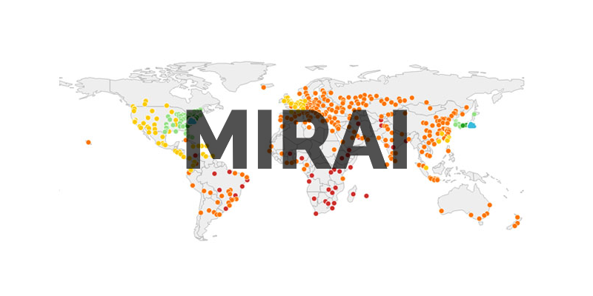
A malware that turns computer systems running Linux into remotely controlled "bots", that can be used as part of a botnet in large-scale network attacks. It primarily targets online consumer devices such as remote cameras and home routers.

Slide 17
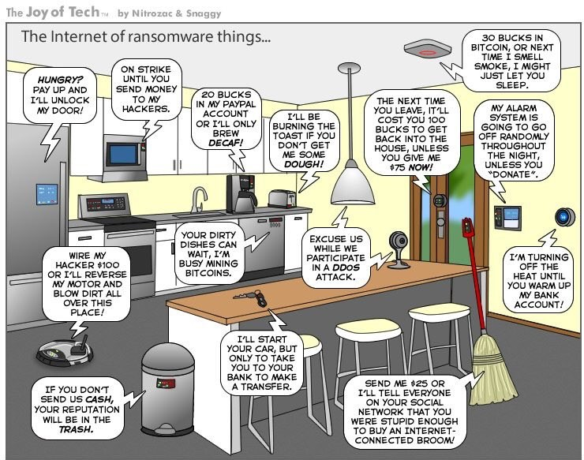
OTA

Slide 18
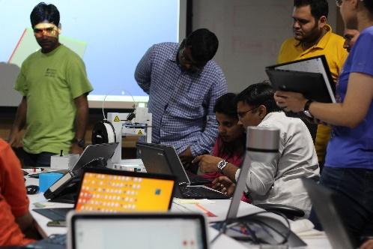
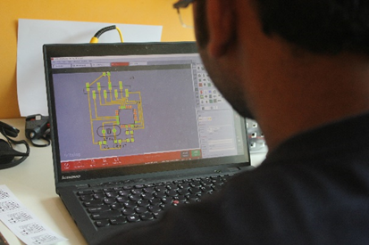


MakerzBay Overview
MakerzBay is a channel for enabling and facilitating IoT focused innovation across the Microsoft Hyderabad campus –
Specially-designed physical space with tools, technology, equipment, and the environment required to bring ideas to life
Helps envision, ideate, and building futuristic scenarios through bleeding edge technology like IoT
Enable others to ‘make’
Develop prototypes
Build industry interfaces
Enable others to innovate
Develop prototypes
Build industry interfaces
Resources & space
Biz scenario enablement
Outside-in perspective
Skill development
Whitespace innovation
Mentorship & Coaching
Market Insight
Technical Knowhow
Design & Envisioning
Industry Connect
Build Failures
Showcase
makerzbayfte@microsoft.com

